Slide 1
So you want to start a company
Dane Boysen, PhD
Cyclotron Road, Berkeley CA
November 9, 2015

Slide 2
my story

Slide 3


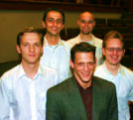

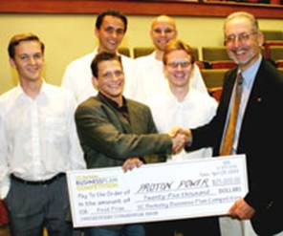
been there

Slide 4
Surest sign to an unsuccessful start-up is winning a business plan competition

Slide 5
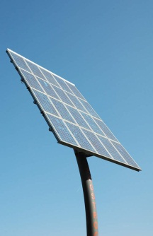
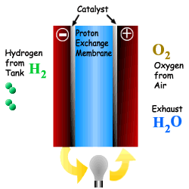


Fuel Cells what is a fuel cell?
catalyst
hydrogen
from
the sun
Hydrogen from fuel
H₂
hydrogen from fuel
H₂
O₂
oxygen from air
H₂O
water bi-product
electrolyte
alcohol
oil
electricity

Slide 6
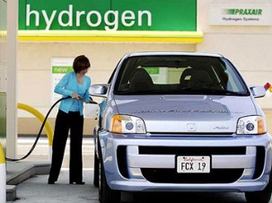
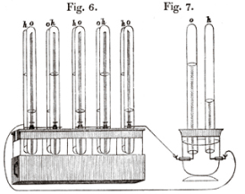
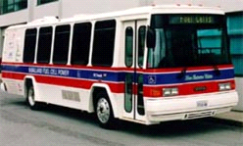
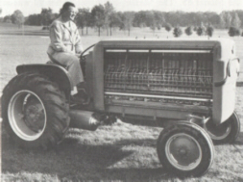
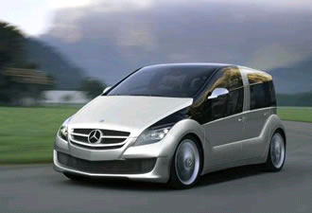
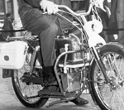
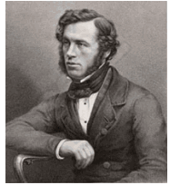
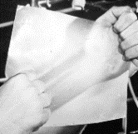
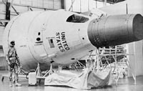
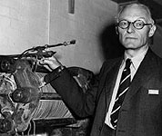
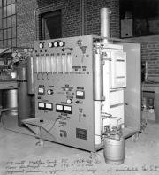
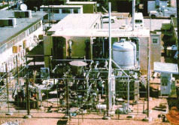
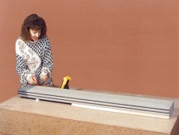
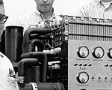
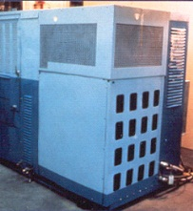
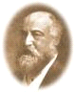
History of Fuel Cells more than 150 years and no mass adoption
Union Carbide
-
General Electric
AFC powered
-
1
motorcycle
st
polymer fuel
cell (PEMFC) in
Gemini space craft
Ballard Systems
-
100 kW PEMFC
transit bus
Daimler Benz &
Sir William Grove
-
Honda
1st fuel cell
PEMFC cars
1839
1955
1959
1967
1993
1997
1889
1932
1962
1964
1965
1979
1997
Ludwig
Mond
&
WestingHouse
Allis
United Technologies
-
-
Chalmers
1
solid oxide
Charles Langer
st
-
-
40 kW PAFC
-
coin
fuel cell (SOFC)
5 kW phosphoric
“
fuel cell
”
acid fuel cell (PAFC)
Texas Instruments
Power Corporation
Francis T. Bacon
100 W Molten
-
250 kW MCFC
-
1
alkaline
st
Carbonate Fuel
fuel cell (AFC)
Cell (MCFC)

Slide 7
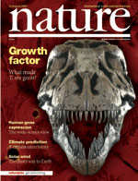
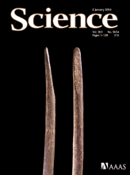
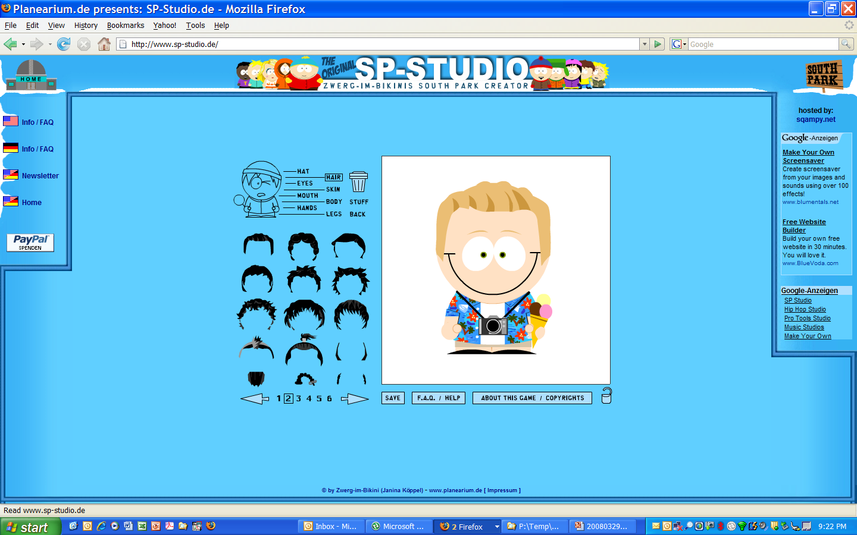
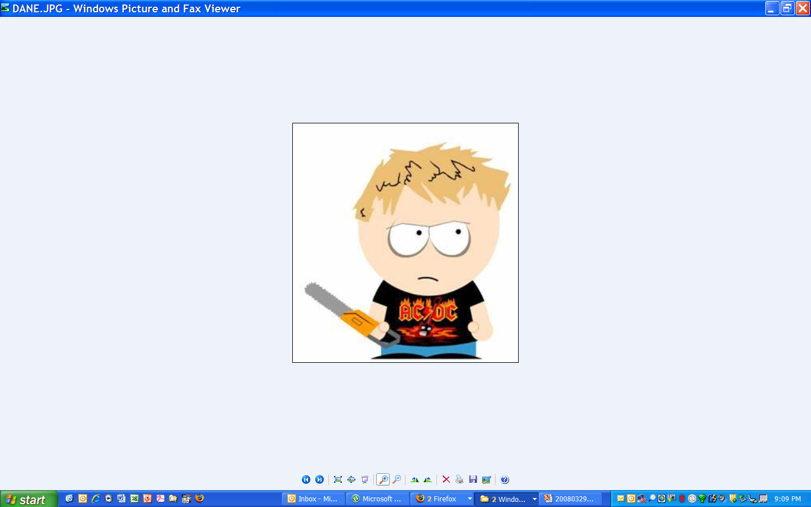
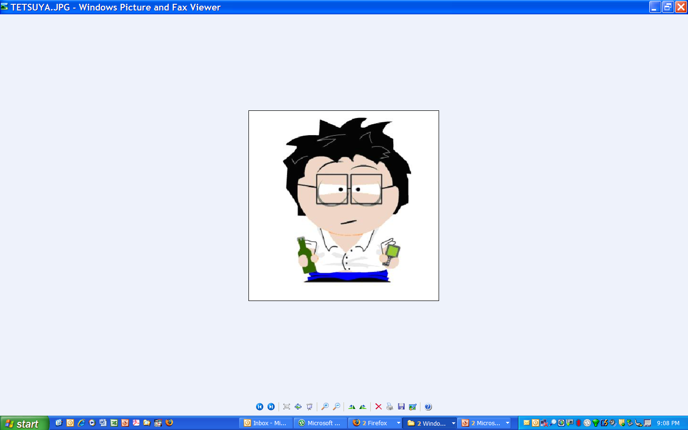
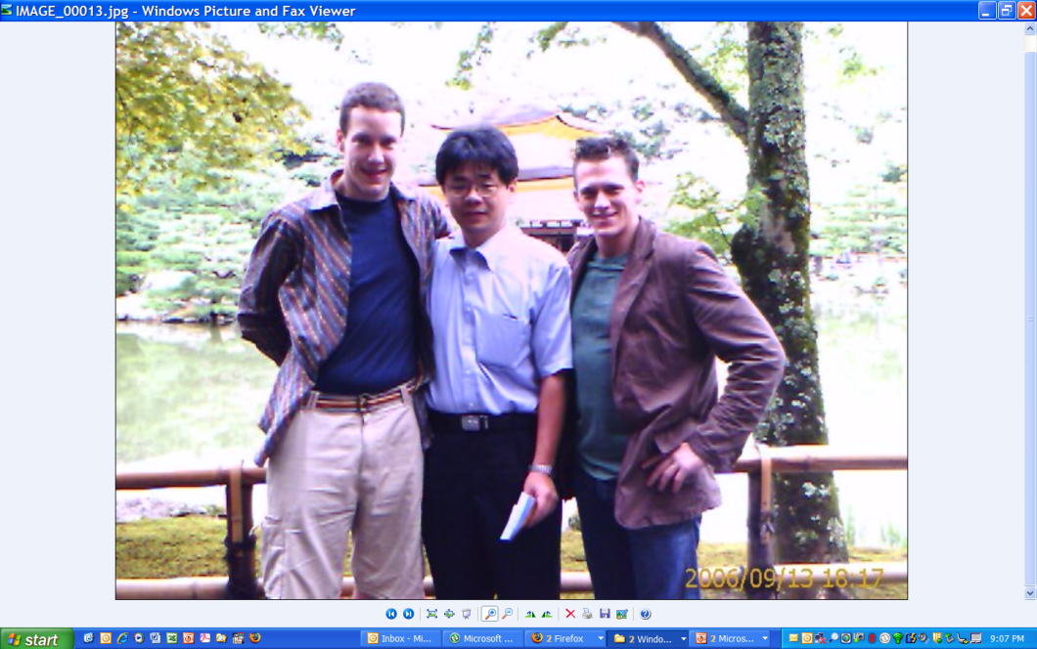
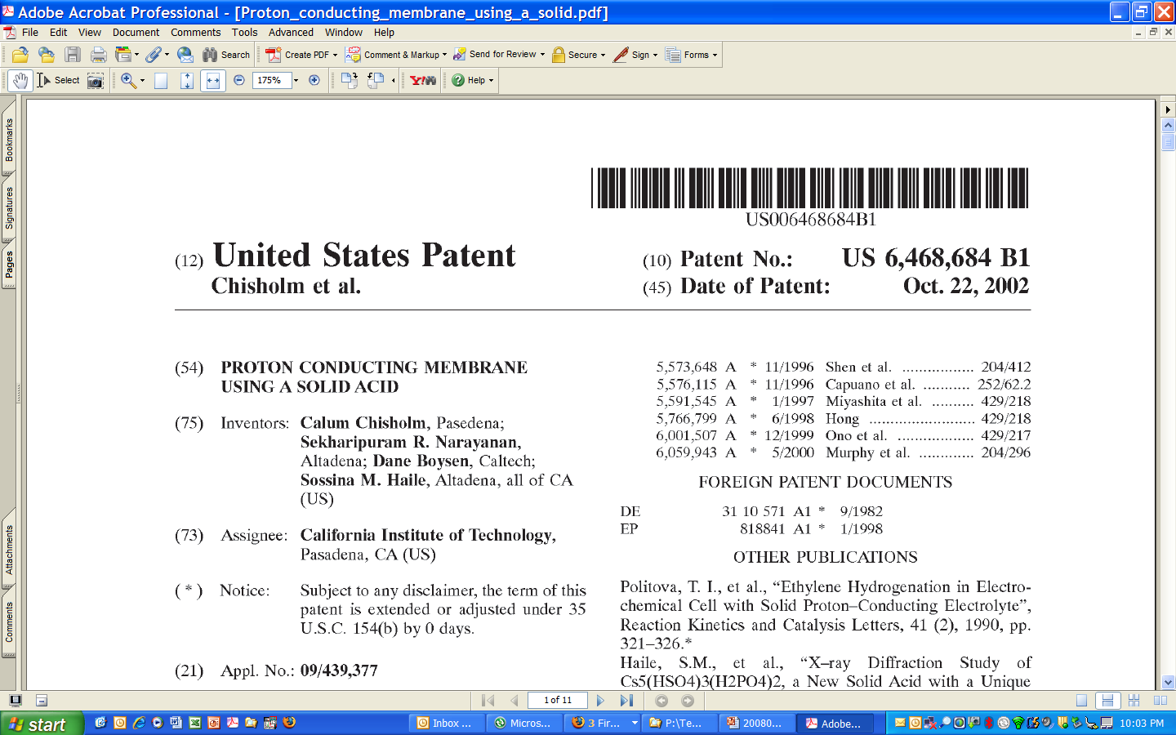

2004, discovered solid acid fuel cells first new type of fuel cell in 50 years
Calum
Tetsuya
Dane

Slide 8
What is a solid acid?
Arrhenius Plot of
Solid Acid Proton Conductivity
Intermediate salts and acids
½ Cs₂SO₄+ ½ H₂SO₄ → CsHSO₄
Physically similar to salts
Brittle
Water soluble
Properties
Direct proton transport
Impermeable
Solid state
Superprotonic
Notes:
8

Slide 9
Superprotonic Phase Transitions
Structural solid-solid phase transition (order-disorder)
Heat → 100 -1000 fold increase in proton conductivity
Superprotonic (σ ~ 10⁻² Ω⁻¹cm⁻¹)
Oxy-anions “freely” rotate
Ordered
Normal Structure
Disordered
Superprotonic
Cs⁺
heat
H⁺
SO₄^{–2}
Notes:
9

Slide 10
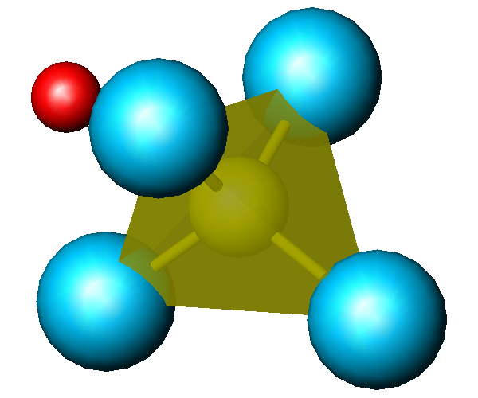
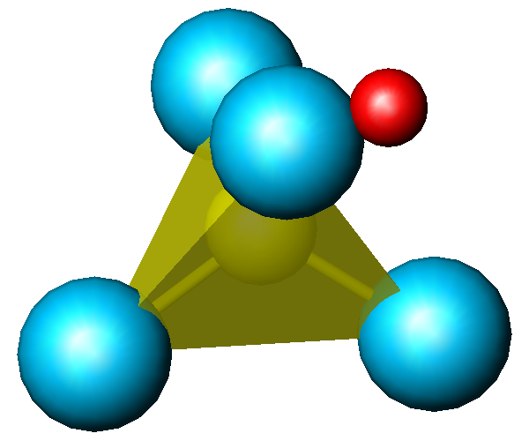
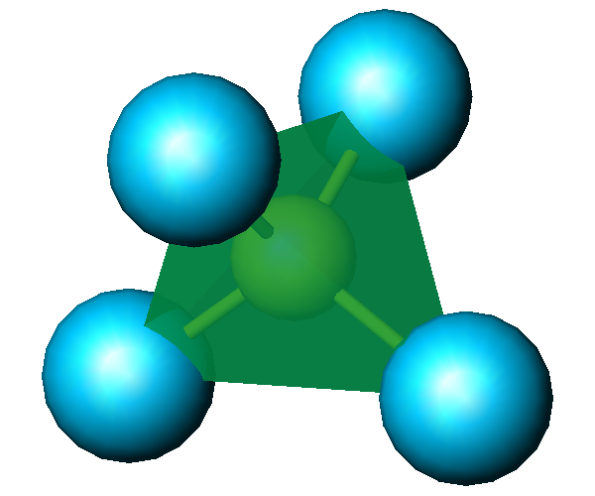
Proton Transport Mechanism (Grotthuss Mechanism)
1. Tetrahedral Reorientation
2. Proton Transfer
10¹² Hz
H
S
O
10⁹ Hz
liquid-like proton conduction in the solid state
Notes:
10

Slide 11
A New Class of Fuel Cells
Discovery | Type | Temp | Achilles’ Heal
1930 Bacon | AFC Alkaline | 120-160°C | Needs pure H₂/O₂
1937 Baur & Preiss | SOFC Solld Oxide | 600-1000°C | Thermal cycling Seal degradation Expensive interconnects
1957 Broers & Ketelaar | MCFC Molten Carbonate | 600°C | Electrolyte loss Seal degradation Corrosive environment
1959 Grubbs | PAFC Phosphoric Acid | 120-200°C | Corrosive environment Catalyst degradation Electrode flooding
1961 Elmor & Tanner | PEFC Polymer Electrolyte | 60-100°C | Water management Catalyst degradation CO contamination
2004 Boysen, Chisholm, Haile | SAFC Solid Acid | 150-300°C | To be determined
Notes:
11
11
To much on a this slide
Keep discovery, achilles
Lose electrolyte or ion species

Slide 12


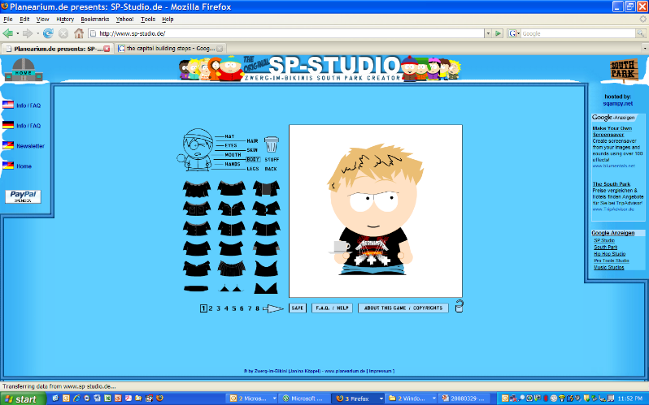
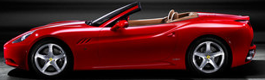

We’re gonna be rich!

Slide 13
Begging the government for money
Heh, heh... sounds great boys, but we need that money for fightin’ the turists

Slide 14
The Technology Valley of Death venture capital, the only game in town
~ $30 billion and 3,000 investments per year in start-up companies

Slide 15
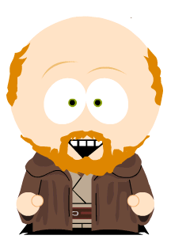
We need a CEO
Okay, but you will have to learn the ways of the force if you are to come with me to raise money
Hey dude, want to be our CEO?
Cool

Slide 16
Getting venture capital (VC) to Sand Hill Road

Slide 17
Jun 2004, after nearly 100 pitches & 3 months we finally close our Series A ($4.5MM)
Notes:
1) El diablo nos da cinco millones de dólares, pero él toma nuestras almas.

Slide 18
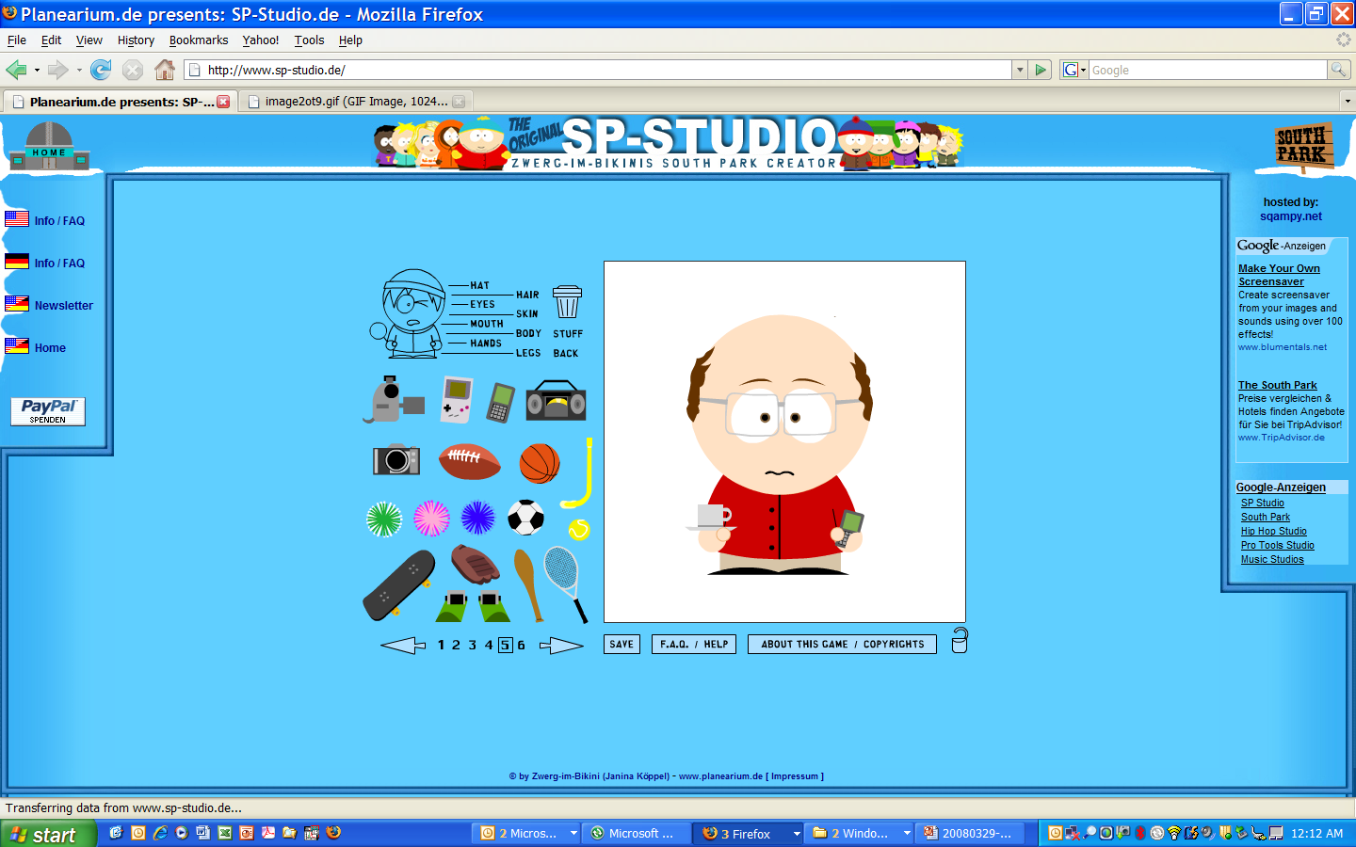
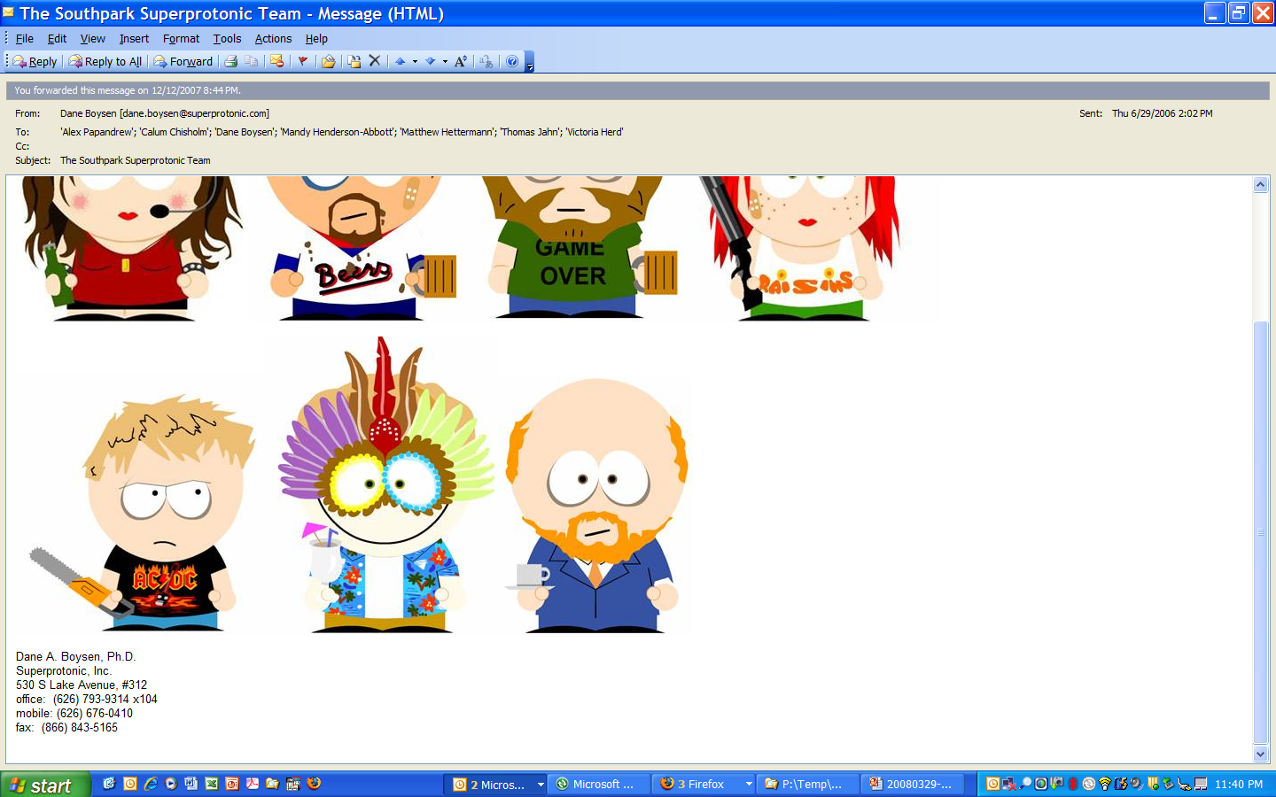
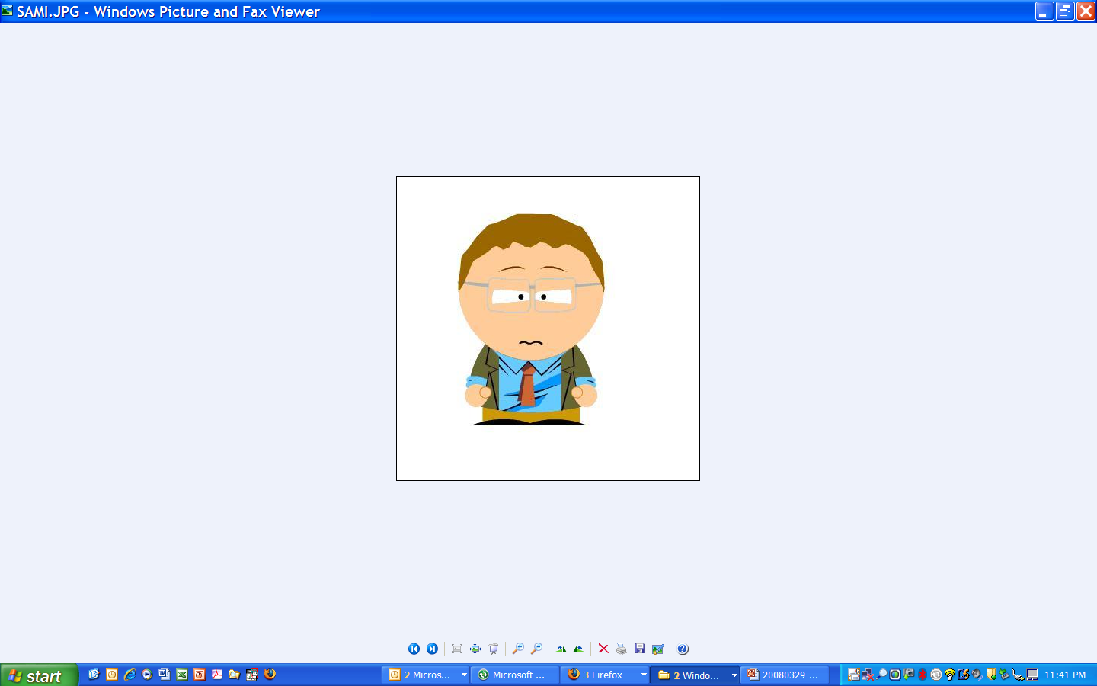
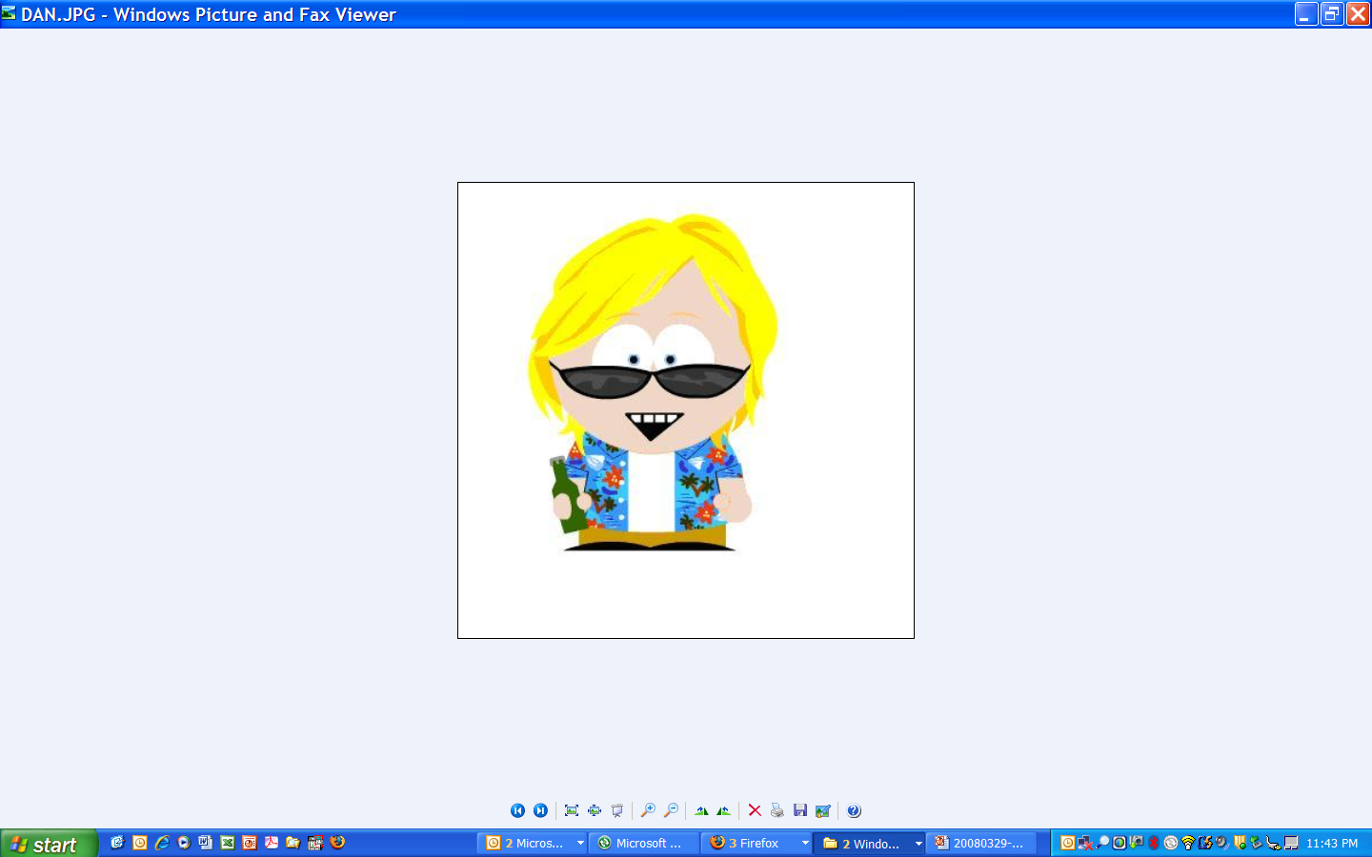
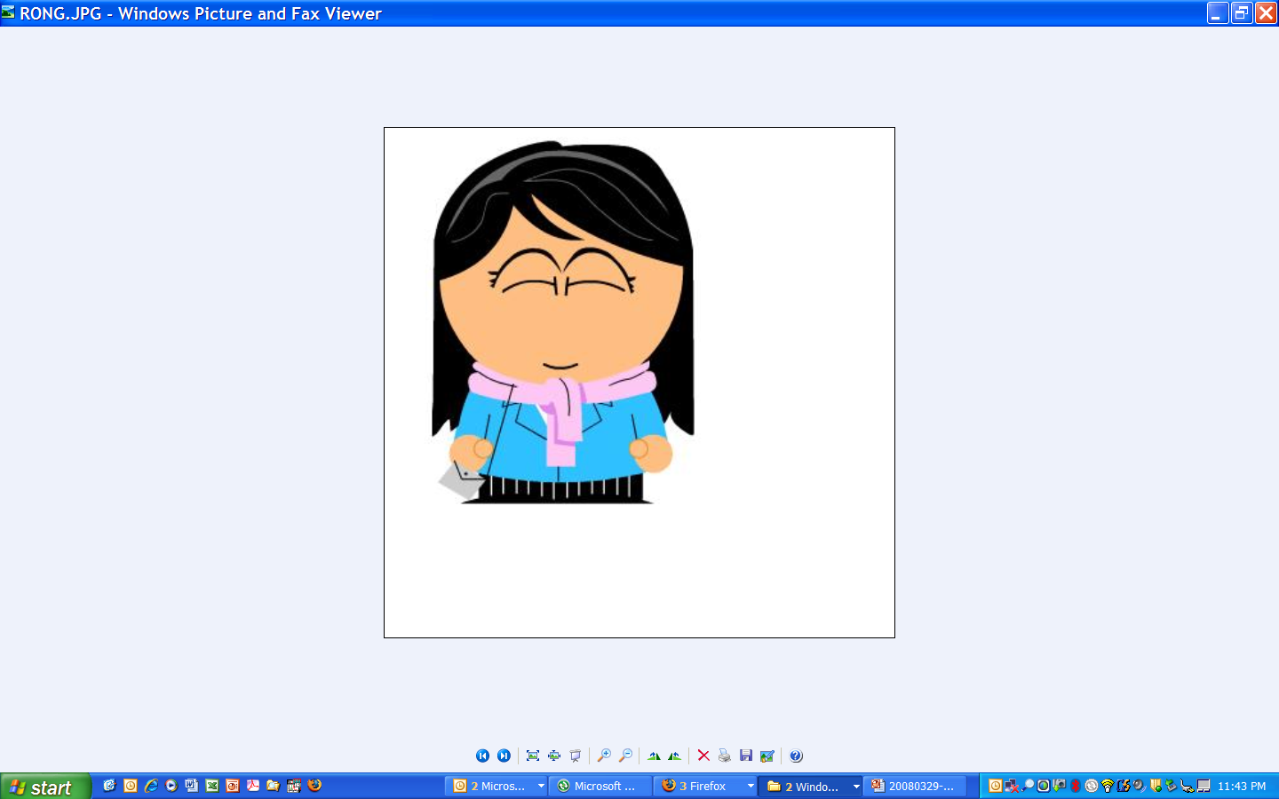
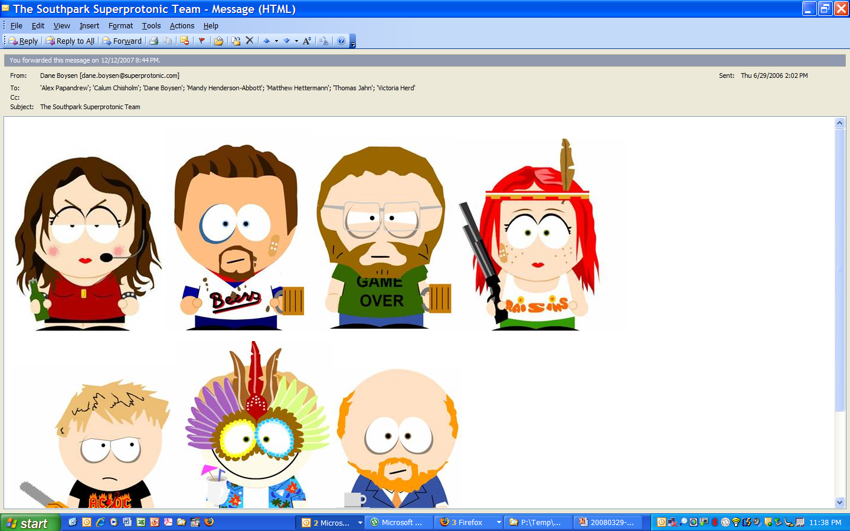

We build a fantastic team original Superprotonic Team
Thomas
CEO
Sami
VP Biz Dev
Zeka
Sr. Scientist
Dan
Jr. Engineer
Rong
Sr. Engineer
Founders
Vikki
Office Mgr.
Matt
VP Engineering
Alex
Sr. Scientist
Mandy
Lab Mgr.

Slide 19
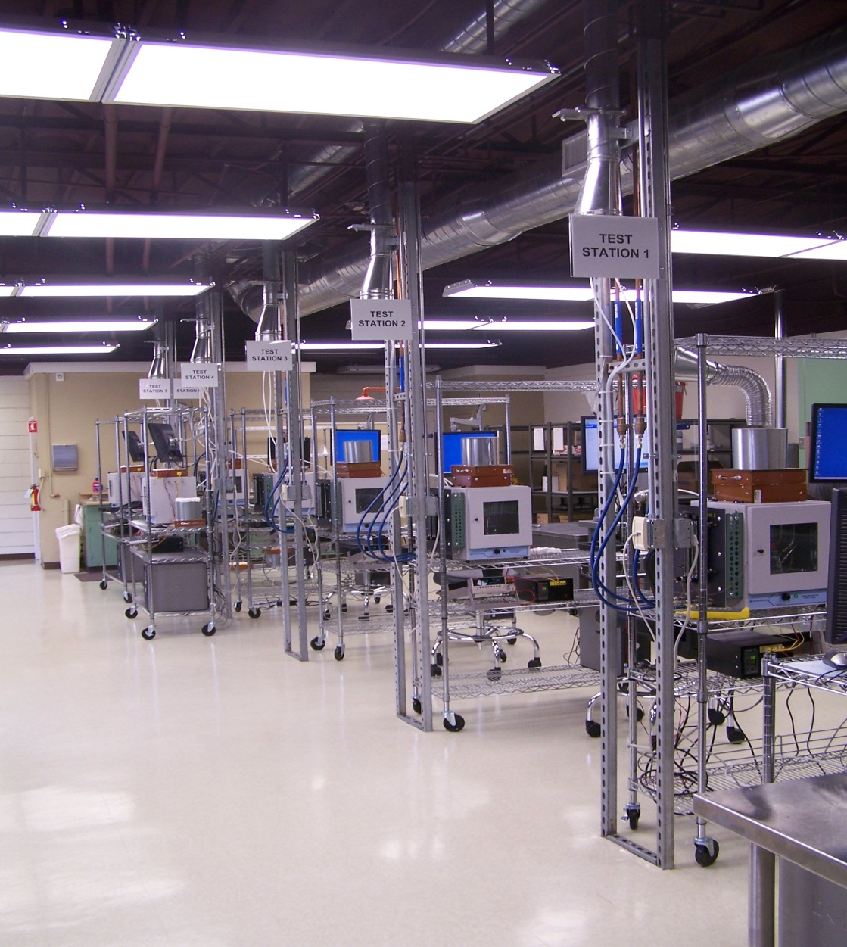

We build a laboratory …money is flyin’ out the window
from lease to fully operational lab in 50 days

Slide 20
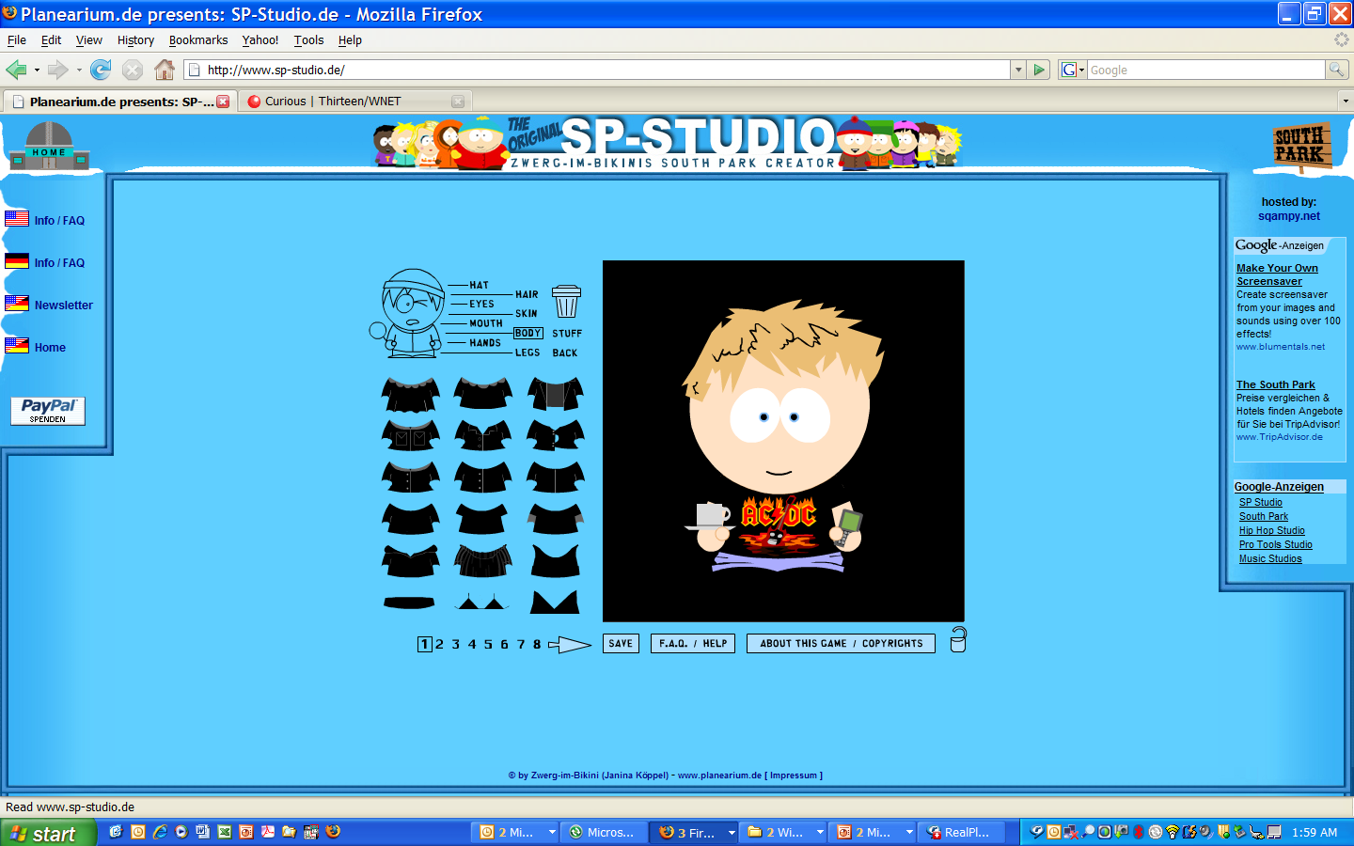
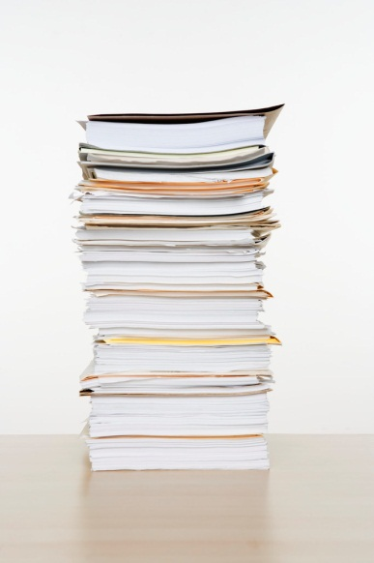
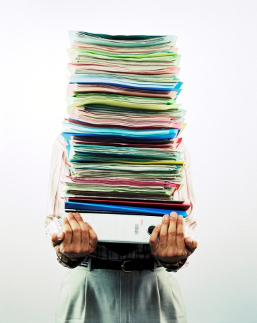
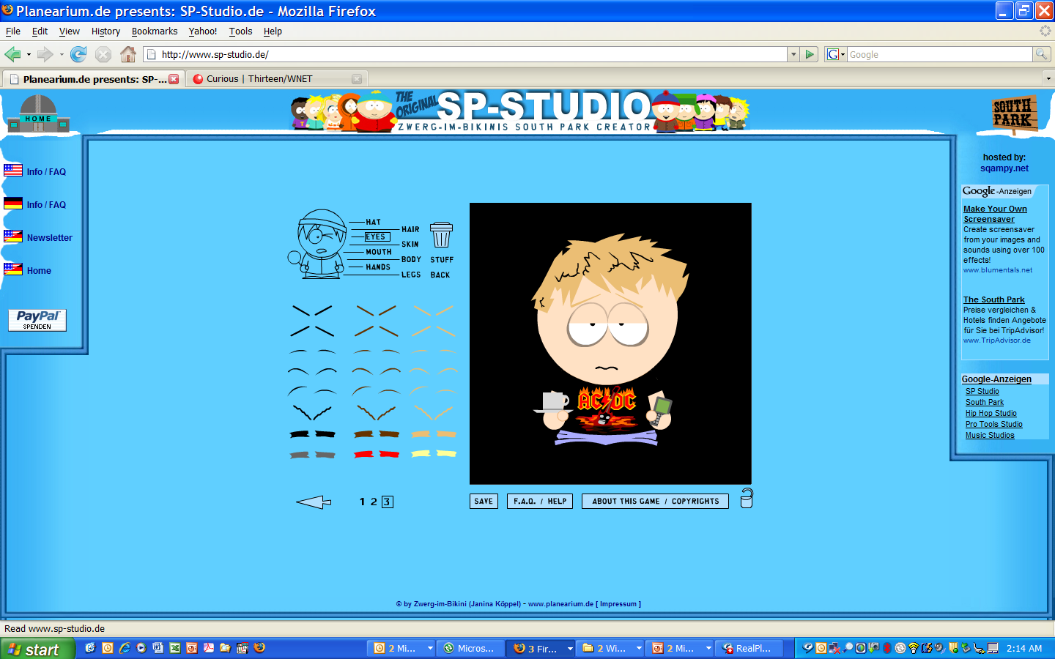


Workin’ hard typical weeks ~ 100 hours
7:00 AM
1:00 AM
Notes:
1) Después, esto es el tiempo para el trabajo difícil.
2) Voy al trabajo muy temprano por la mañana.
3) Entonces, trabajo hasta muy tarde por la noche hasta que yo esté cansado.
4) Generalmente, trabajo siete días por semana.

Slide 21
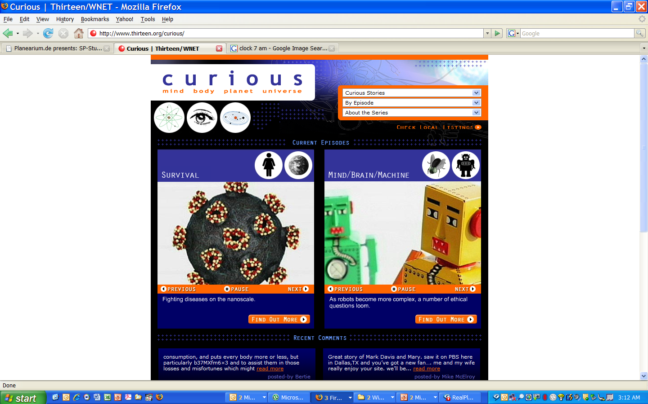
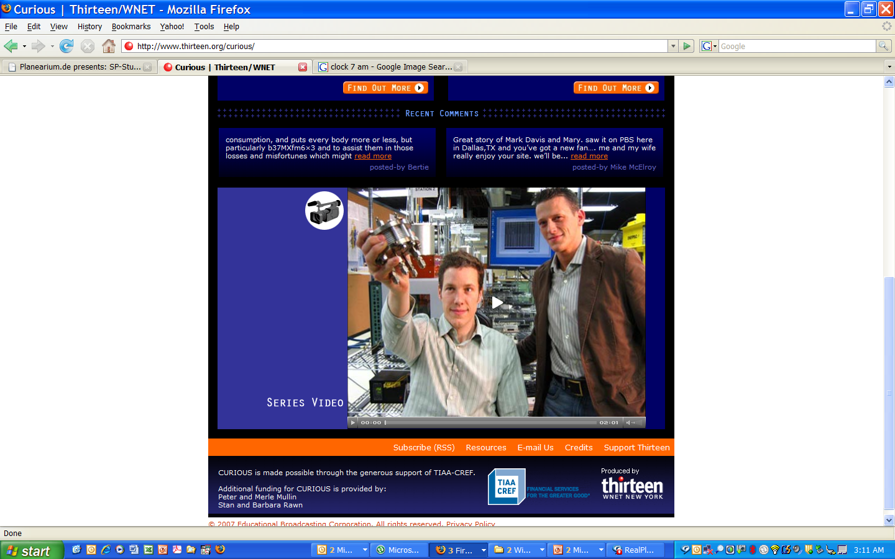
15 min of fame
featured in PBS series called 'Curious'
Getting press doesn’t make it real
Notes:
1) Nosotros estamos vivos todavía con mucho trabaj0 - por el momento
2) Nos disponemos a fabricar.
3) Tenemos a quince empleados.
4) Nosotros vamos a estar en televisión en el programa llamado ‘Curious’.

Slide 22
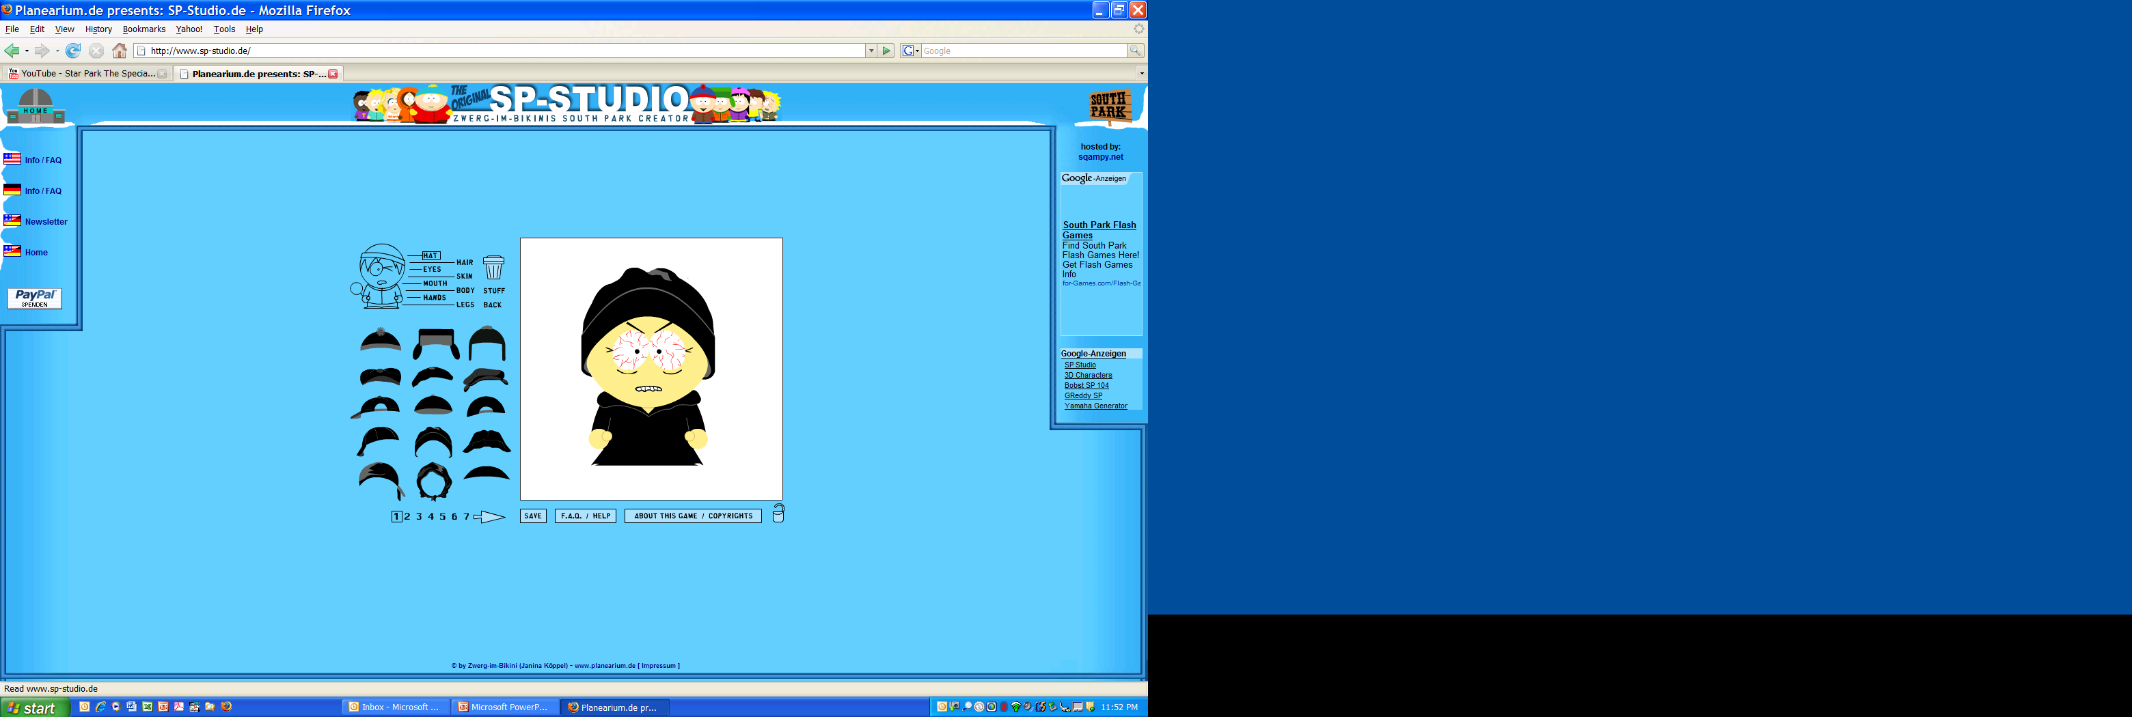
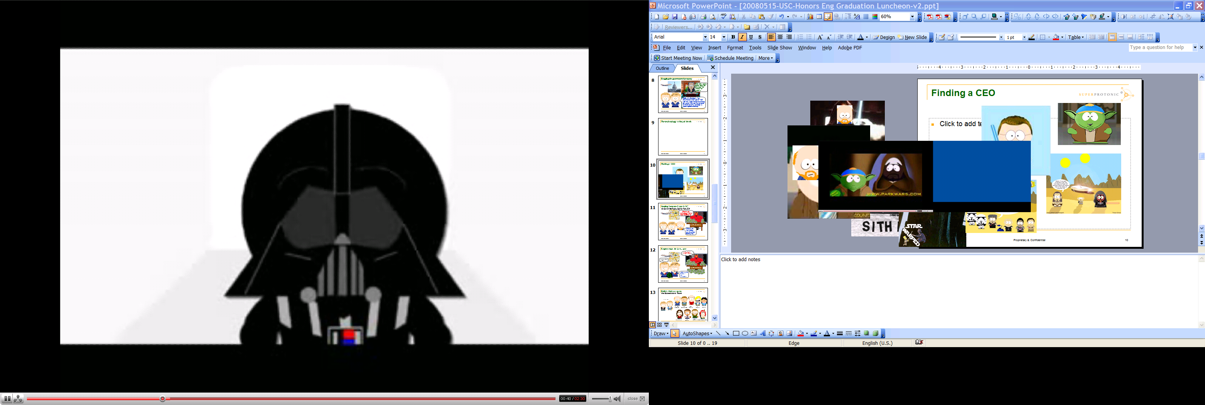
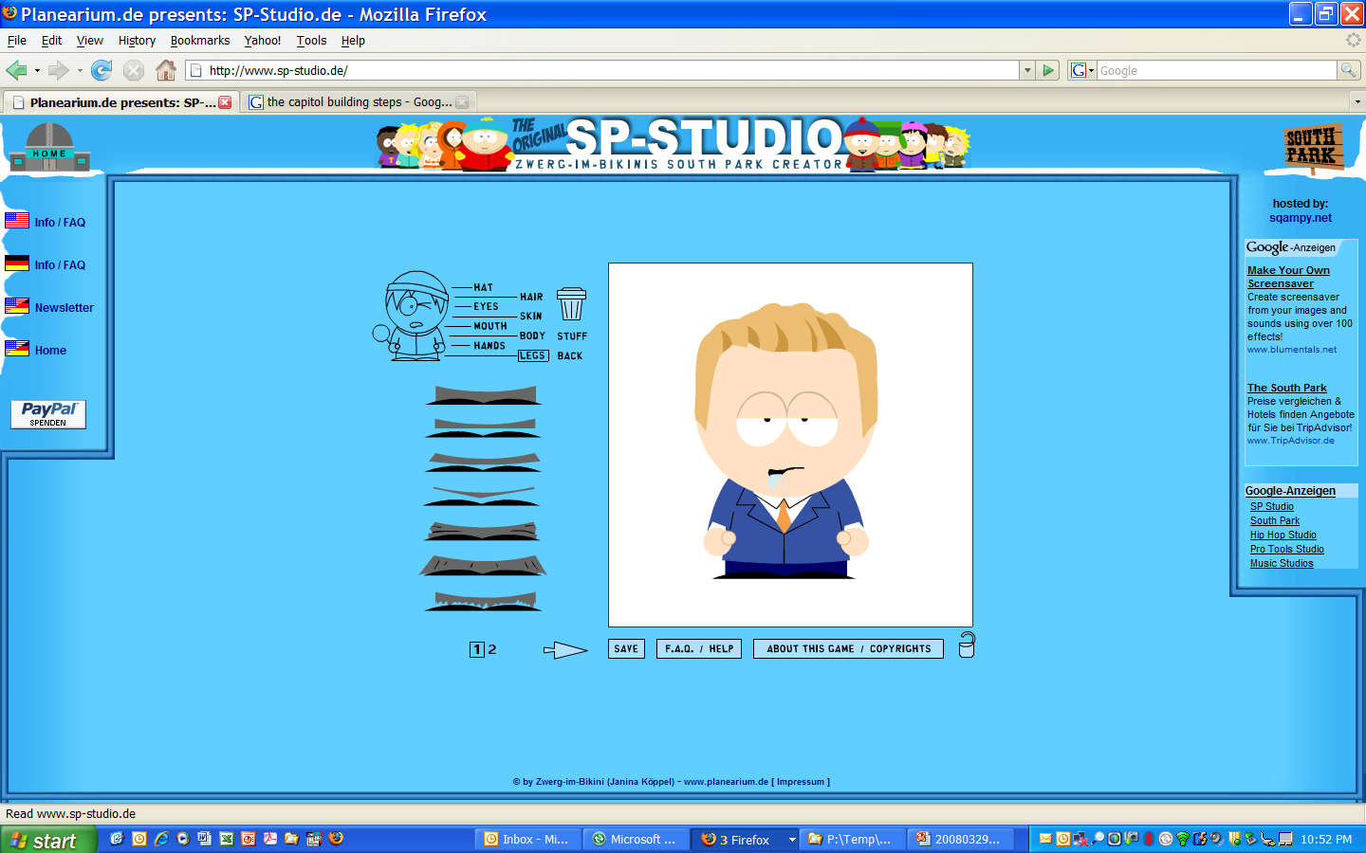
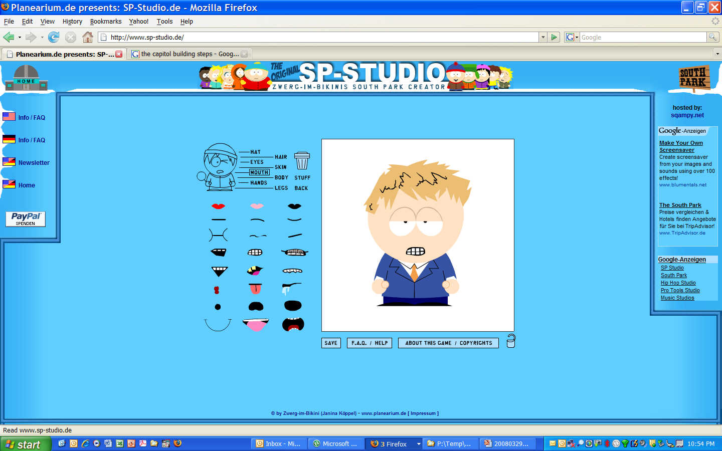

Dec 2006, we’re out of cash time to raise more money
I get it. You lie to me and tell me you are going to hit all your milestones and make me a ton of money, and I lie to you that I am your friend and am not going to screw you.
No, really these guys are awesome.
Can I just kill them now?
Venture Capitalist
We’re going to make you a pile of money!

Slide 23

Jun 2007, we close Series B ($15MM) …and they axed our CEO
This isn’t lookin’ so good
Founders
11%
New CEO
VC 89%
$23MM

Slide 24



2008, decision to ramp up for manufacturing …are we ready???
Notes:
Construimos una fábrica.
y tuvo una apertura grande a la que muchos políticos importantes fueron.
We build a manufacturing facility.
and had a grand openning at which many high level policitians attended.

Slide 25

2008 New Superprotonic Team
note likeness
Notes:
1) Entonces, contratamos más personas.
1) Then, we hire more people.

Slide 26





Rapid Technological Development
Li-ion Battery
< 0.2 Wh kg⁻¹
Solid Acid Fuel Cell
> 1.0 Wh kg⁻¹
preliminary evaluation & negotiation with
~ $500/kWh
~ $5000/kWh
big companies often want to date for 5 years before getting married
Notes:
Nuestra tecnología tiene cinco veces más densidad que la energía de las baterías de litio-ión.
Por ejemplo, si su computadora puede operar por cinco horas con una batería, operará por un día con nuestra fuel cell.
1) Our technology has five times the energy density of lithium-ion batteries.
2) For example, if your computer can operate for 5 hours on a battery, it will run for 1 day on our fuel cell.
kilovatio-hora por kilogramo

Slide 27

2009 Economic Crisis
DOW
13,000
12,000
11,000
10,000
9,000
8,000
Superprotonic
dissolved
market crash
2008
2009
2010
2011

Slide 28
Dane’s Top Ten words of advice about starting a company
The only reason to start a business is to make money
Time is more valuable than money – make the most of it
Worship the holy trinity – team, market, technology (in that order)
You can never fire a bad employee fast enough
Figure out how to get to revenue in less than 1 year
Energy technology market adoption times >10 years
Success has a thousand fathers, failure is bastard child
There is no such thing as bad money – it is about timing
A patent is only a right to sue
Better to agree, than be right

Slide 29
Thank you
Dane A. Boysen
dane.Boysen@gmail.com
(626) 676-0410

Slide 30



Solid Fuel Cell Technology Wins First Prize at the UC Berkeley Business Plan Competition
Berkeley, Ca 2005

